Slide 1
Automated Accident Recovery through IoT

Slide 2
Problem statement
Every year over 137 million people die due to a delay in calling an ambulance.
Victims may lose their lives even before reaching the hospital.
Main aim of this project is to overcome this problem by using IoT.

Slide 3
Proposed Solution
Vehicle equipped with sensors sends a request to nearby ambulance organization by matching zip code of the place where accident happened.
Nearest ambulance arrives immediately.
In the mean time smart watch gets a health report of patients condition.
This report will be forwarded to the doctor by a receptionist.
Receptionist attaches all the x-ray reports with the request and forwards it to a Doctor.
Doctor analyses these data and updates the case.
Ambulance can inform family members about patient’s status though an SMS.
A police organization is also simultaneously notifies about the case.
A police can print a detailed case report.

Slide 4
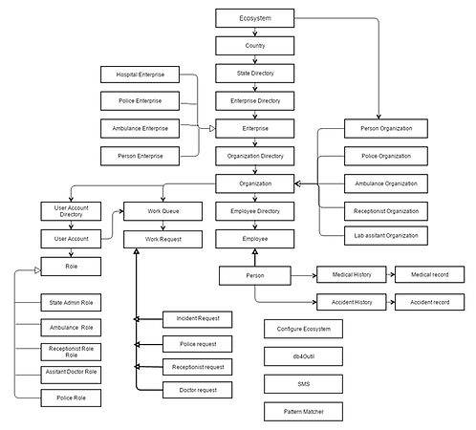
Object Model

Slide 5
Key Roles
Person Role
Ambulance Role
Receptionist Role
Lab Assistant Role
Police Role
Admin Role
State Admin Role

Slide 6
Features
Signing up a person.
Immediate request sent to nearest ambulance after an accident.
Simultaneous medical report captured by the ambulance and forwarded to receptionist.
Uploading X-Ray images by receptionist.
Uploaded images viewed by an assistant doctor.
Analysis done by doctor.
Police organization generates printed pdf report.

Slide 7
Extra Features
SMS functionality – Enables ambulance to keep victim’s family of updated about the status.
PDF generation – Police generates these reports.
X-ray images : Done by receptionist for doctor to view.

